Slide 1
Employment Report
First half of 2021
Labour market key indicators
Lisbon, October 2021

Slide 2

Macroeconomic framework
Production, demand and prices
GDP AND MAIN COMPONENTS OF EXPENDITURE – ANNUAL PERCENTAGE RATE OF CHANGE (EXPENDITURE APPROACH, RATE OF CHANGE IN VOLUME)
 | 2021 |  | 2020 |  |  |  | 2020 | 2019
 | Q2 | Q1 | Q4 | Q3 | Q2 | Q1
GDP (EU) (a) | 13,8 | -1,2 | -4,1 | -3,9 | -13,7 | -2,5 | -5,9 | 1,8
GDP pps (PT) (b) | 16,2 | -5,7 | -6,8 | -6,3 | -17,9 | -2,6 | -8,4 | 2,7
Domestic demand | 15,7 | -3,6 | -3,2 | -4,4 | -13,8 | -0,9 | -5,6 | 3,0
Final consumption expenditure of resident households | 16,8 | -5,2 | -4,0 | -3,3 | -14,4 | -0,5 | -5,5 | 3,0
General government final consumption expenditure | 9,8 | 2,2 | 2,2 | 2,4 | -3,8 | 0,9 | 0,4 | 2,1
Gross capital formation | 11,0 | 3,7 | 0,4 | -9,6 | -11,2 | -2,4 | -5,7 | 3,2
Gross fixed capital formation | 12,9 | 2,9 | 0,4 | -0,5 | -9,9 | -1,0 | -2,7 | 5,4
Exports of goods (FOB) and services | 40,0 | -9,4 | -14,4 | -15,6 | -39,3 | -5,6 | -18,6 | 4,1
Imports of goods (FOB) and services | 35,5 | -4,3 | -6,2 | -11,1 | -29,9 | -1,5 | -12,1 | 4,9
Source: Table (a) EUROSTAT (Table [nama_10_gdp] and [namq_10_gdp]; (b) INE, National accounts

Slide 3
Macroeconomic framework
Production, demand and prices
Harmonised Index of Consumer Prices – Annual rate of change (Monthly data)
Source: EUROSTAT, table [prc_hicp_manr].

Slide 4
Macroeconomic framework
Production, demand and prices
Harmonised Index of Consumer Prices – Annual rate of change (Monthly data)
Source : EUROSTAT, table [prc_hicp_manr].

Slide 5
Macroeconomic framework
Production, demand and prices
Harmonised Index of Consumer Prices – Annual rate of change (Monthly data)
Source : EUROSTAT, table [prc_hicp_manr].

Slide 6
LABOUR MARKET
Activity, employment and unemployment
Active, inactive and employed population
Source : INE, Labour force survey

Slide 7
LABOUR MARKET
Activity, employment and unemployment
Activity rate
Source : INE, Labour force survey

Slide 8
LABOUR MARKET
Activity, employment and unemployment
Employment rate
Source : INE, Labour force survey

Slide 9
LABOUR MARKET
Activity, employment and unemployment
EMPLOYEES BY TYPE OF CONTRACT
Source : INE, Labour force survey

Slide 10
LABOUR MARKET
Activity, employment and unemployment
POPULATION EMPLOYED BY SECTORS OF ACTIVITY
A | Agriculture, forestry and fishing | M | Professional, scientific and technical activities
C | Manufacturing | N | Administrative and support service activities
F | Construction | O | Public administration and defence; compulsory social security
G | Wholesale and retail trade; repair of motor vehicles and motorcycles | P | Education
H | Transportation and storage | Q | Human health and social work activities
I | Accommodation and food service activities | R | Arts, entertainment and recreation
J | Information and communication | S | Other service activities
K | Financial and insurance activities | T | Activities of Households as Employers; Undifferentiate Goods and Services Producing Activities of Households for Own Use
L | Real estate activities
Source : INE, Labour force survey

Slide 11
LABOUR MARKET
Activity, employment and unemployment
Unemployment rate
Source : INE, Labour force survey

Slide 12
LABOUR MARKET
Activity, employment and unemployment
Unemployment rate by region
Source : INE, Labour force survey

Slide 13
LABOUR MARKET
Activity, employment and unemployment
UNEMPLOYED POPULATION BY DURATION OF JOB SEARCH
Source : INE, Labour force survey

Slide 14
LABOUR MARKET
Activity, employment and unemployment
REGISTERED UNEMPLOYMENT
Source: IEFP, Labour Market

Slide 15
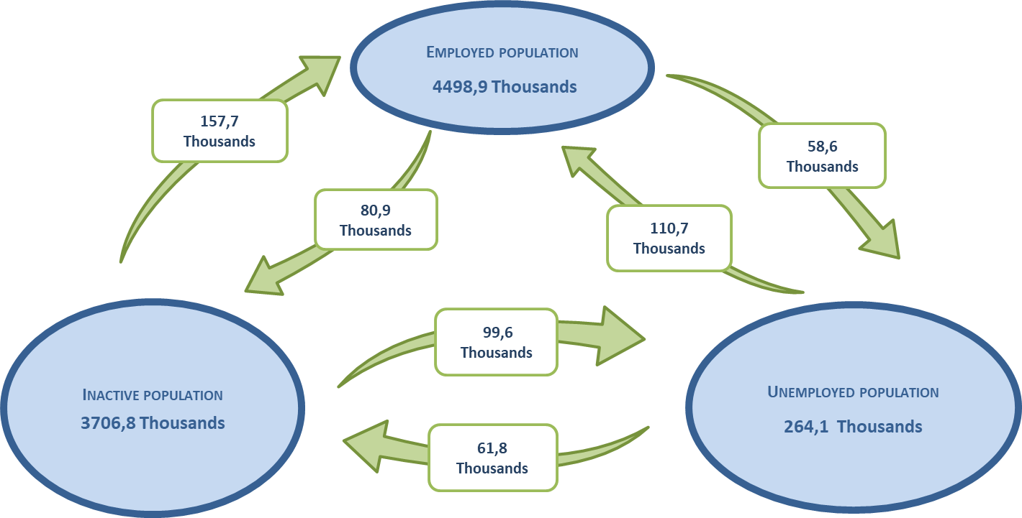
LABOUR MARKET
Activity, employment and unemployment
ENTRY AND EXIT FLOWS BETWEEN INACTIVITY, EMPLOYMENT AND UNEMPLOYMENT
2nd Quarter of 2021
Source: INE, Labour Force Survey

Slide 16
Gains and earnings
EVOLUTION OF THE AVERAGE MONTHLY EARNINGS OF FULL-TIME EMPLOYEES*
€
* latest available information
Source : GEP, Earnings and working time survey

Slide 17
Gains and earnings
EVOLUTION OF THE AVERAGE MONTHLY BASIC REMUNERATION PLUS REGULAR INSTALMENTS OF FULL-TIME EMPLOYEES*
€
* latest available information
Source : GEP, Earnings and working time survey

Slide 18
Gains and earnings
AVERAGE MONTHLY EARNINGS OF FULL-TIME EMPLOYEES BY REGION – APRIL 2019*
€
* latest available information
Source : GEP, Earnings and working time survey

Slide 19
Gains and earnings
AVERAGE MONTHLY EARNINGS OF FULL-TIME EMPLOYEES BY SEX – APRIL 2019*
€
* latest available information
Source : GEP, Earnings and working time survey

Slide 20
LABOUR MARKET
Job offers
JOB OFFERS BY REGION (Situation at the end of the month)
Fonte: IEFP, Labour Market

Slide 21
CENTRE FOR LABOUR RELATIONS
More information at
www.crlaborais.pt

